Slide 1
Customer Retention Project

Slide 2
Problem Statement
We are given a E-retail factors for customer activation and retention . We have to analyse the data and find keys points in retaining customers.

Slide 3
Exploratory Data Analysis
Shape of the data:
This is a small data with 269 rows and 71 columns.
Null values present:
The dataset doesn't have any null values.

Slide 4
Analysing relationship between features

Slide 5
Between Which of the Indian online retailer would you recommend to a friend? And 6 How many times you have made an online purchase in the past 1 year?

Slide 6
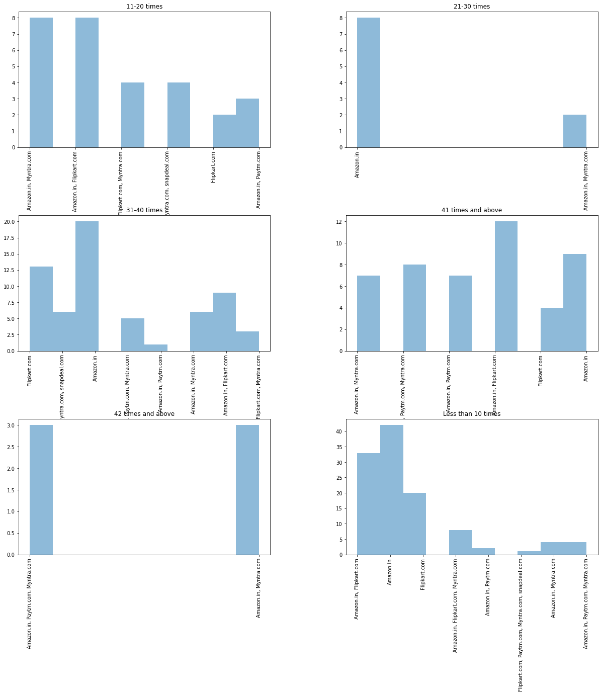

Slide 7
Observation: Irrespective of number of times purchase made online the most recommended website being flipkart and amazon.

Slide 8
Between 15 What is your preferred payment Option? And How many times you have made an online purchase in the past 1 year?

Slide 9
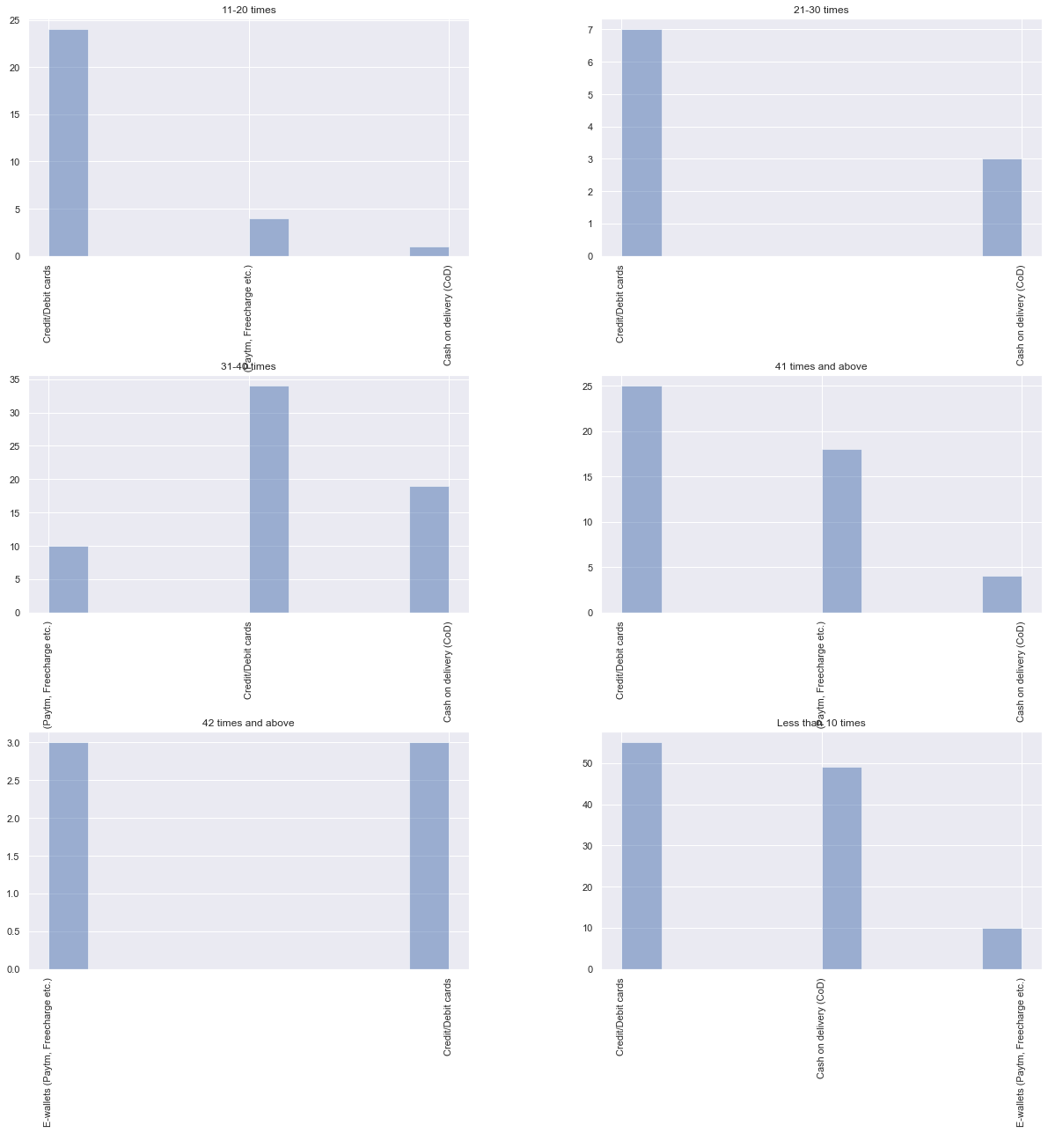

Slide 10
Observation: We could observe that as the number of times customer do online shopping increases, they pay using credit/debit card or E-wallets whereas if the number of times shopping less then COD option is used more. That means once customers gain confidence in that website, they use prepaid options.

Slide 11
Between You feel gratification shopping on your favourite e-tailer and How many times you have made an online purchase in the past 1 year?

Slide 12
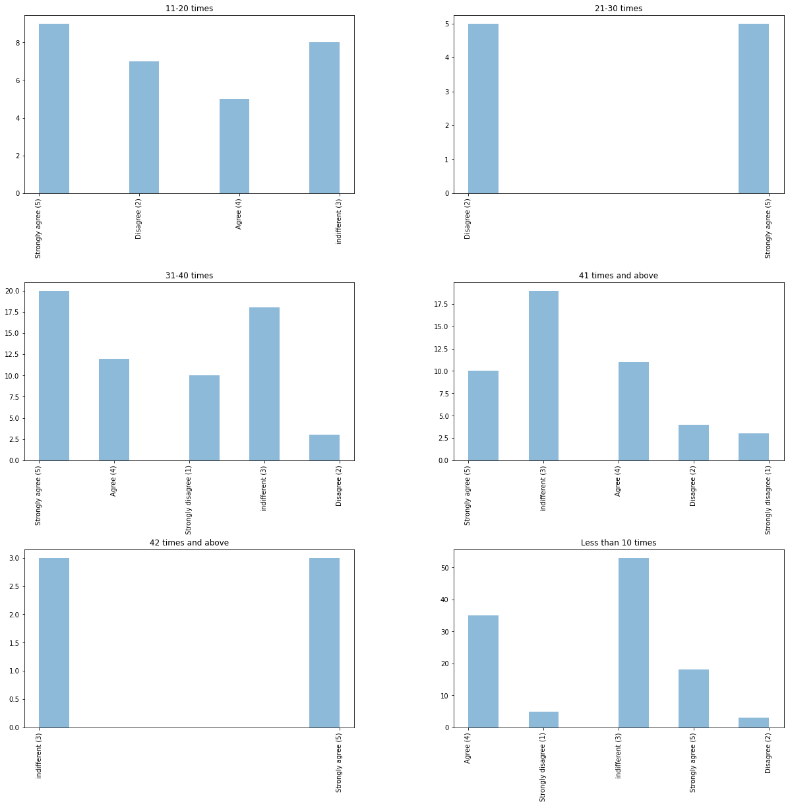

Slide 13
Observation: Most of the time customer is indifferent to feeling gratified.

Slide 14
Shopping on the website helps you fulfil certain roles and How many times you have made an online purchase in the past 1 year?

Slide 15
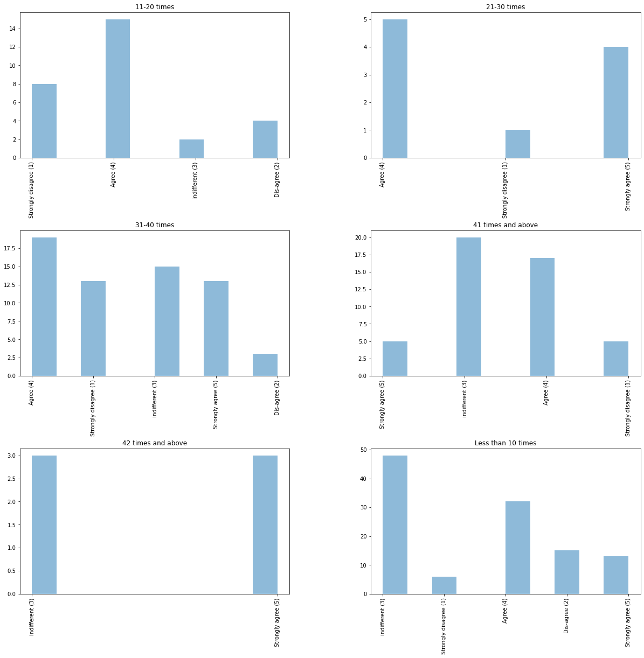

Slide 16
Observation: Most of the time customer is either indifferent or strongly agree that Shopping on the website helps fulfilling certain roles.

Slide 17
Monetary savings and How many times you have made an online purchase in the past 1 year?

Slide 18
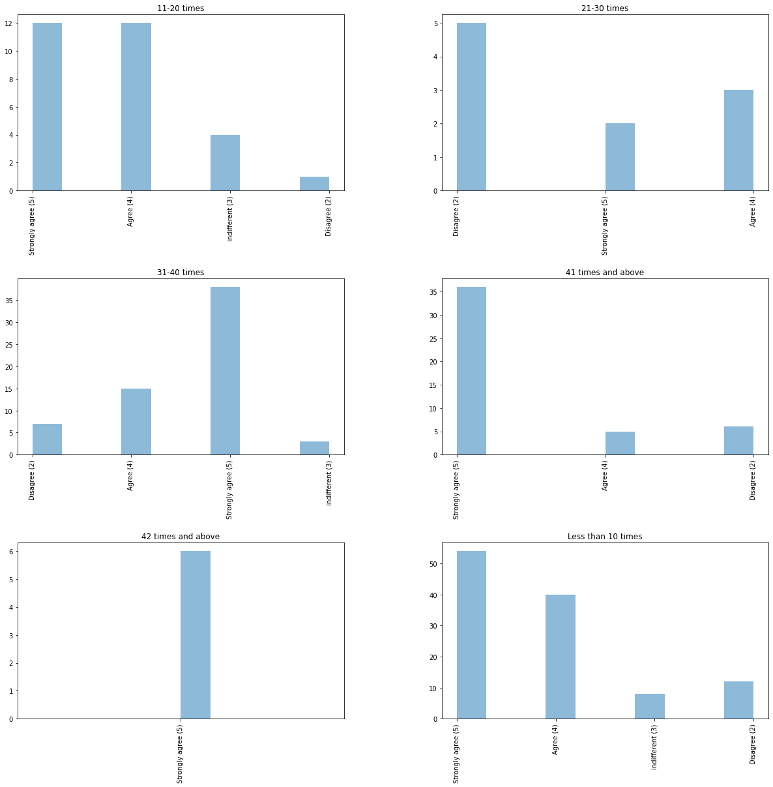

Slide 19
Observation: If the number of purchases is between 20-30 times, maximum customers disagree of monetary savings and in rest customers strongly agree of monetary savings.

Slide 20
Analysing Relationship between features and labels. Considering label as “Which of the Indian online retailer would you recommend to a friend?”

Slide 21
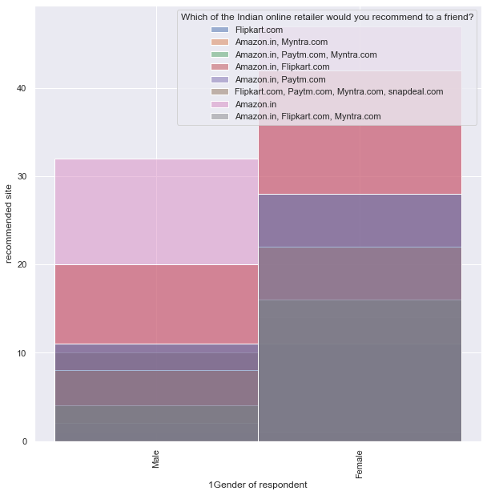
1) Gender

Slide 22
Observation: More number of female buyers as compared to males and maximum number of customers recommend either Amazon or Flipkart.

Slide 23
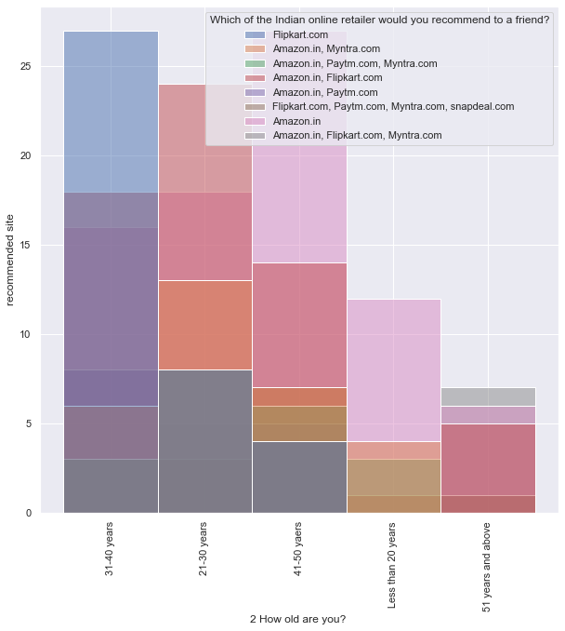
2) Age

Slide 24
Observation: Maximum number of buyers are in the age between 31 to 40 or 41 to 50. The most recommended website from both the age groups are Flipkart and Amazon respectively.

Slide 25
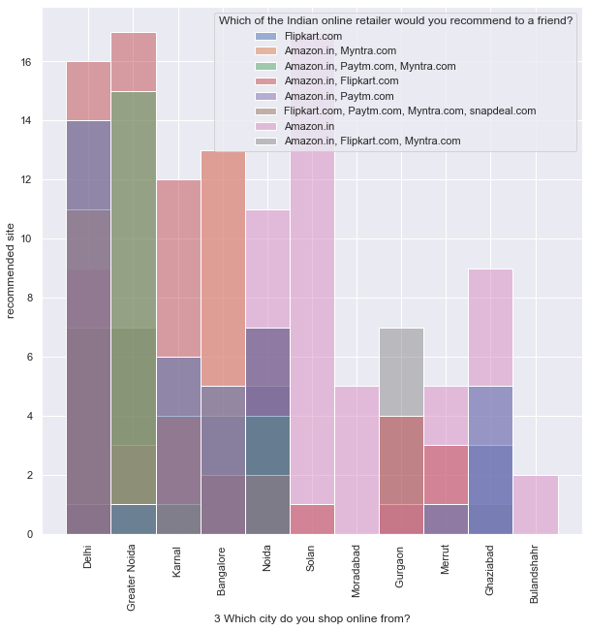
3) Location

Slide 26
Observation: Most shopped city is Greater Noida, Solan and Delhi and buyers there recommend Amazon and Flipkart the most.

Slide 27
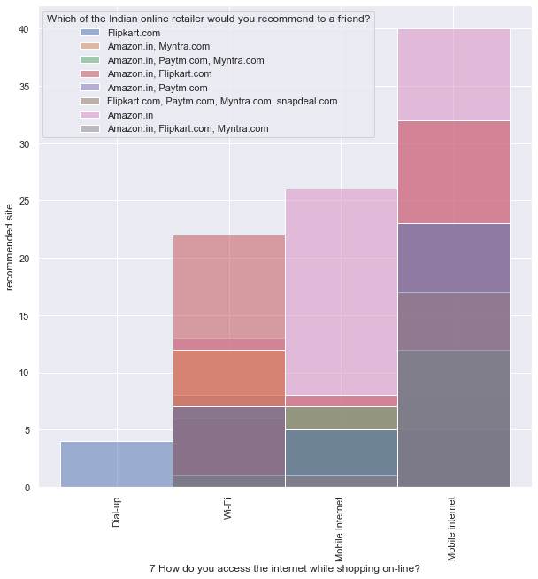
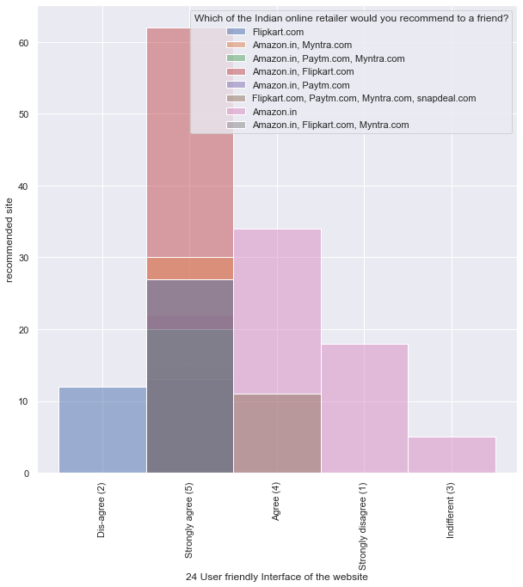
4) User friendliness of website/application

Slide 28
Observation: Most of the times the orders are placed using mobile phone thus websites has to be mobile friendly. Here also the most recommended websites are Amazon and Flipkart that means these provide good mobile screen and user friendly website and app.

Slide 29
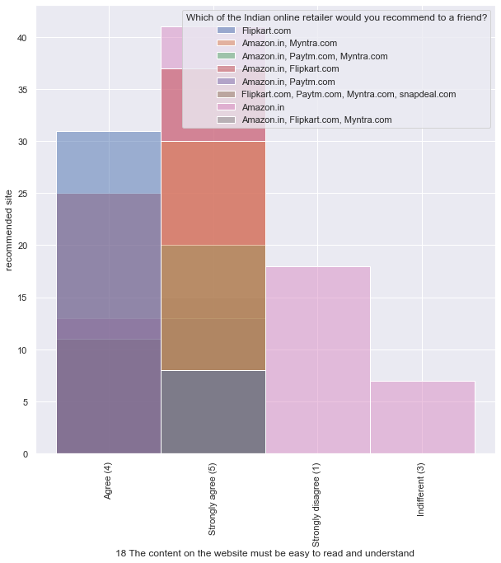
Observation: Whatever we observed in the above graph can be cross checked from this one. People strongly agree that the Amazon and Flipkart website content is easy to understand and read thus they prefer shopping from here.

Slide 30
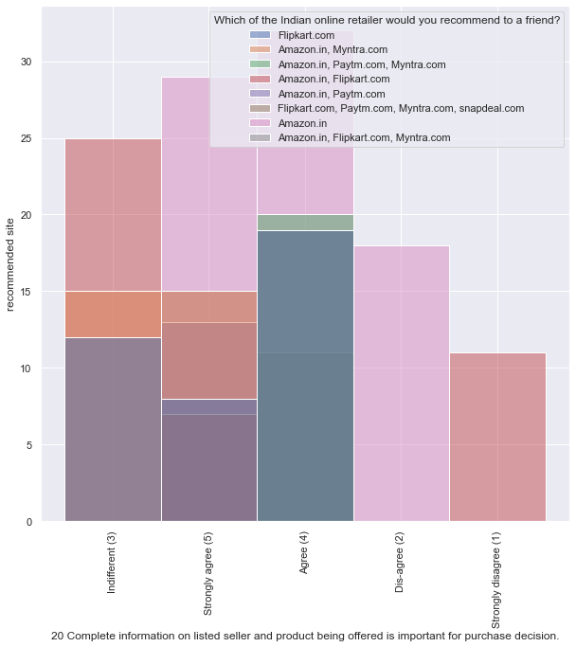
Observation: Maximum people agree and strongly agree that the complete seller information display is important for purchase decision and thus they strongly recommend amazon and flipkart because of same feature.

Slide 31
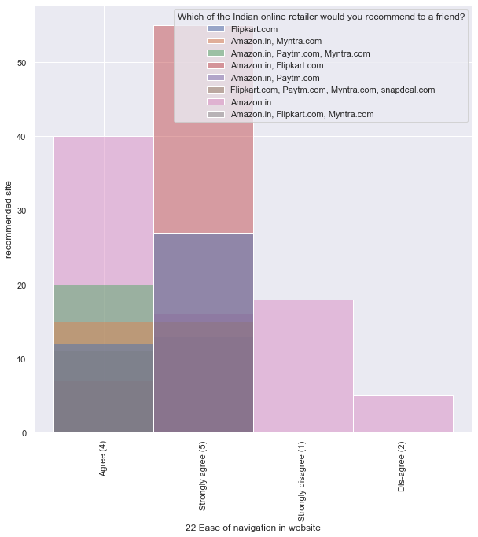
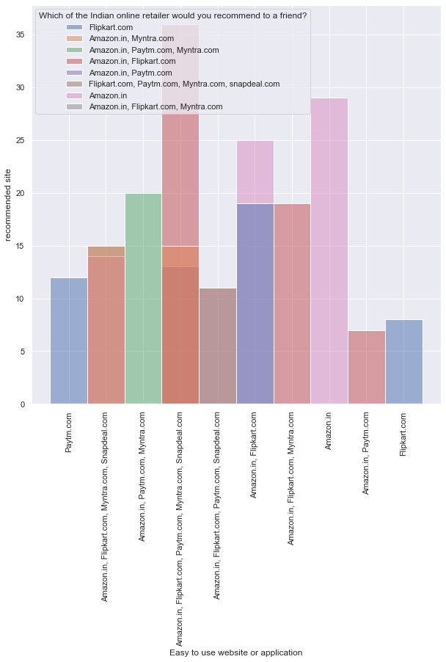

Slide 32
Observation: From the above graphs we can conclude that those websites are strongly recommended which provide ease of navigation in website and are of good quality.

Slide 33
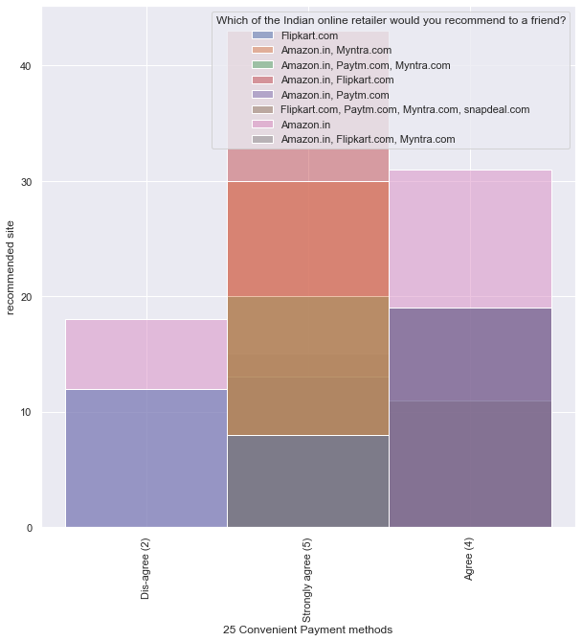
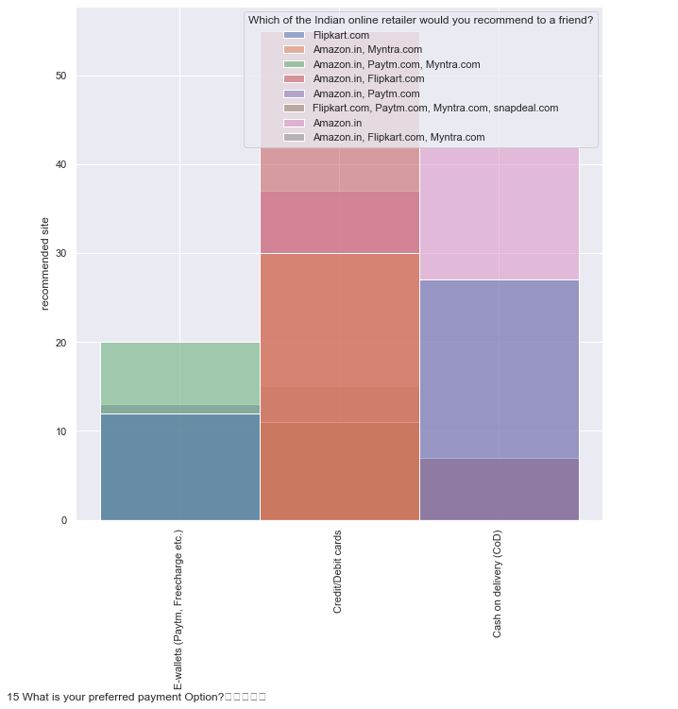
5) Payment

Slide 34
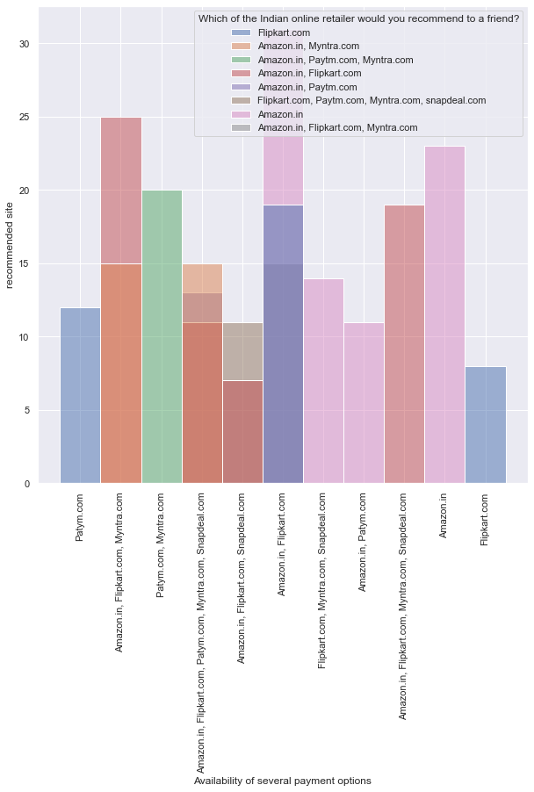
Observation: From the above graphs we can observe that mode of payment that is used most number of times is through credit/debit card and E-wallets are used least. Most of the convenient payment methods are provided by amazon and flipkart and so one of the most recommended websites. These websites also has availability of lot many payment options and so its easy for all section of customers to shop from here.

Slide 35
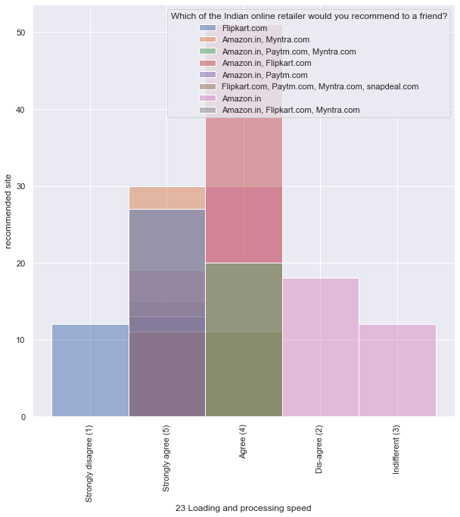
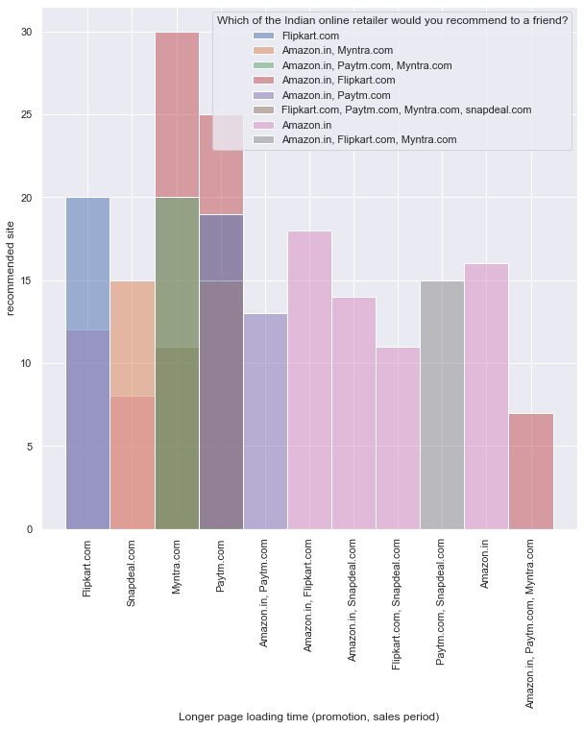
6) Loading and Processing speed

Slide 36
Observation: Loading and processing speed is best for amazon and flipkart thus most of the people recommend this and its an important aspect in doing online shopping with ease. Longer page loading time is of myntra and paytm whereas it is least for amazon.

Slide 37
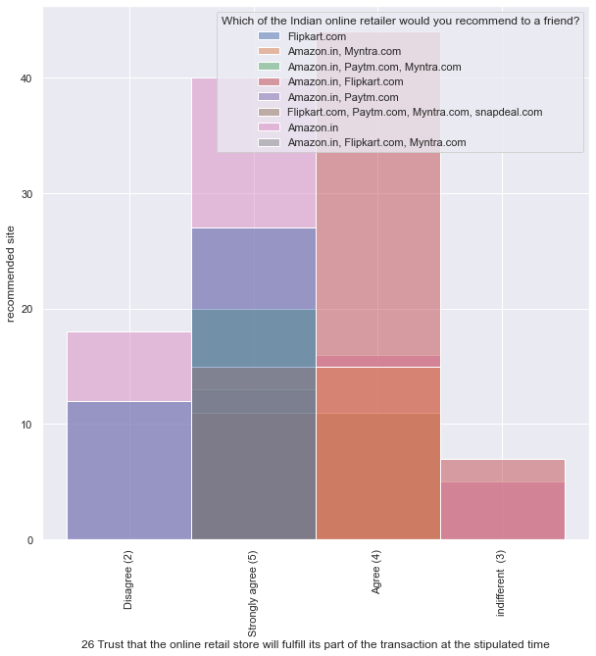
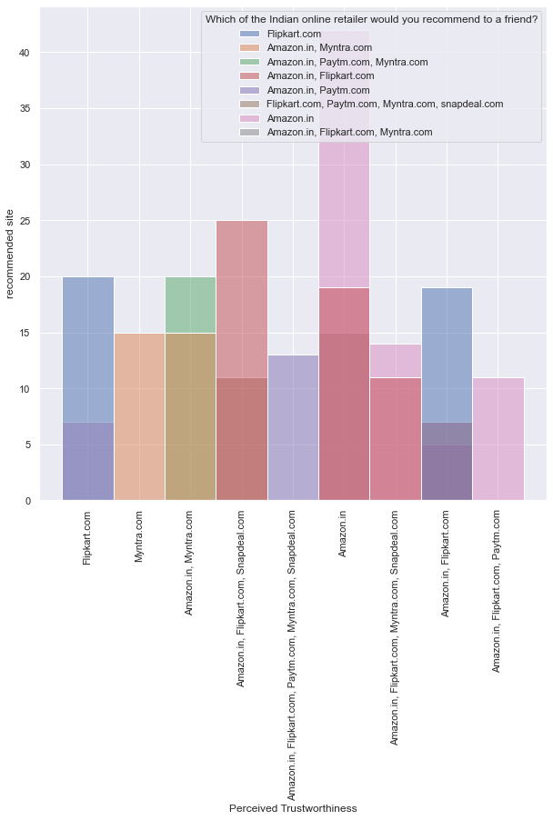
7) Trust and Privacy

Slide 38
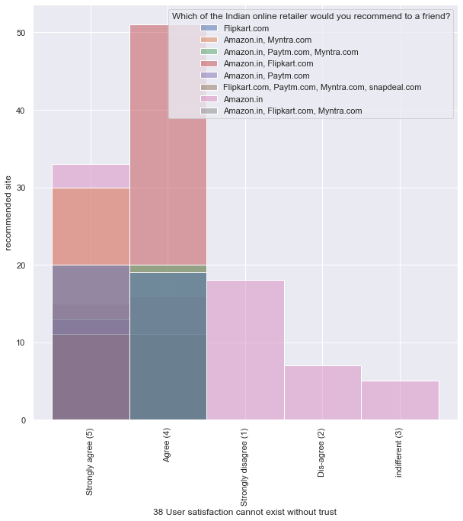
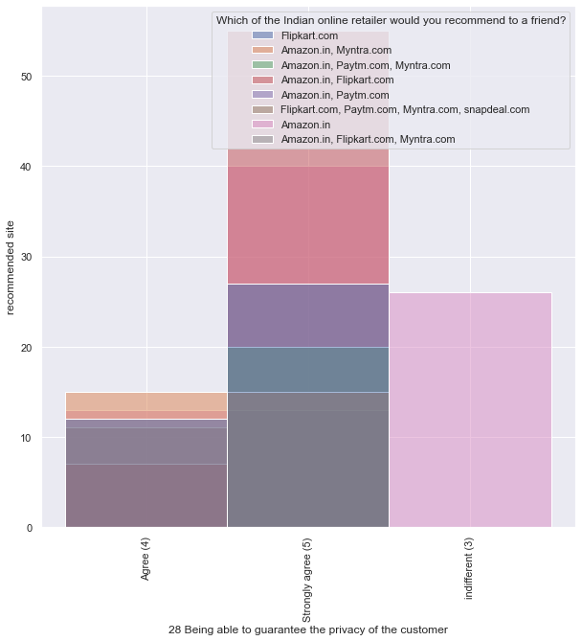

Slide 39
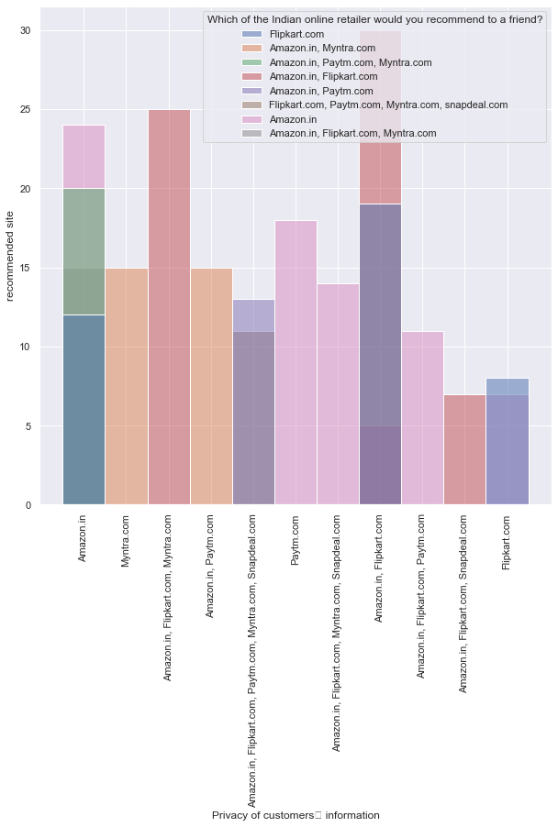
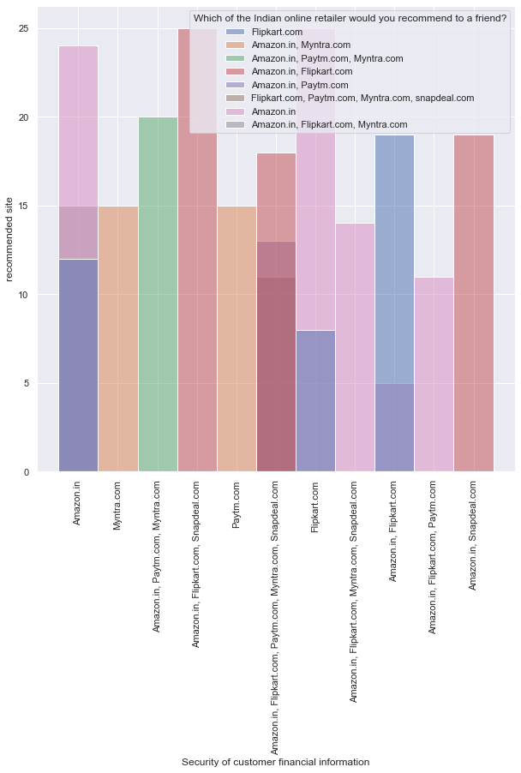

Slide 40
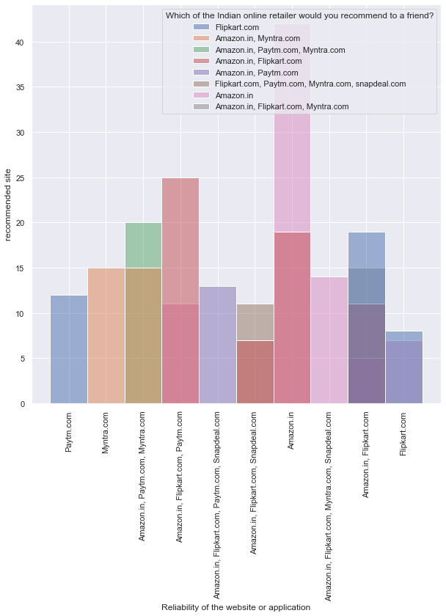
Observation: Customers strongly agree that the online shopping site should provide trust to customers and should give financial data security and privacy. From the above graphs we can conclude that amazon and flipkart are the sites that give reliability, data privacy and customers trust them.

Slide 41
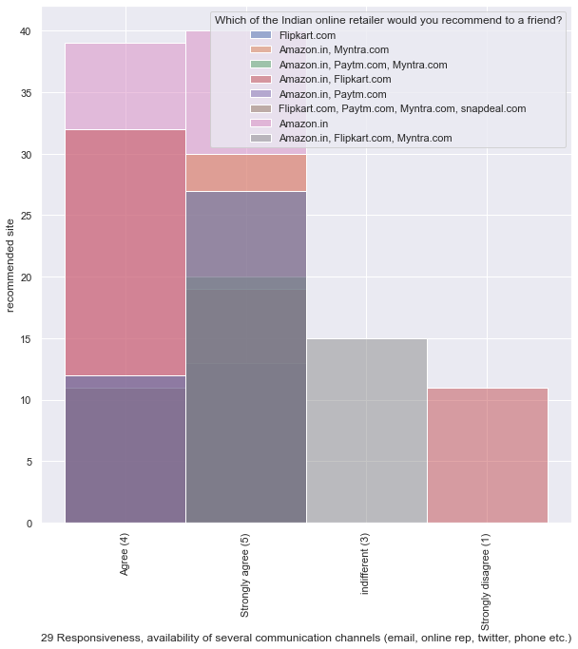
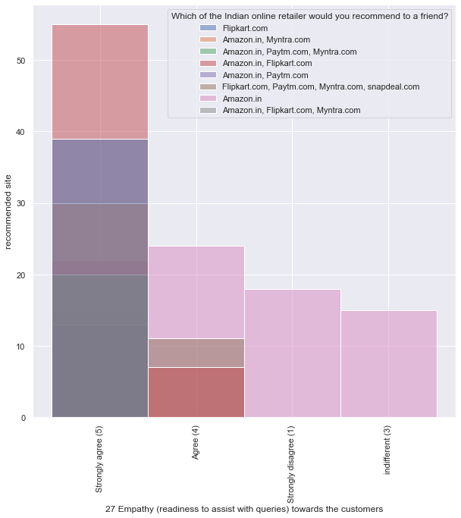
8) Empathy towards customers

Slide 42
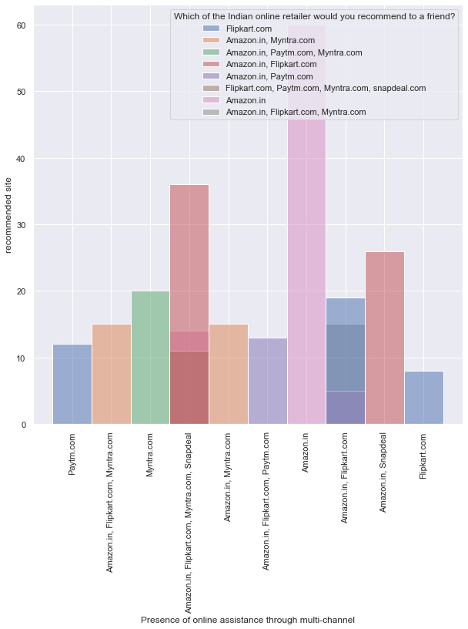
Observation: From the above graphs we could observe that customers prefer those websites that provide empathy, responsiveness and multiple channels to handle their query. Most recommended websites in this context is again amazon and flipkart.

Slide 43
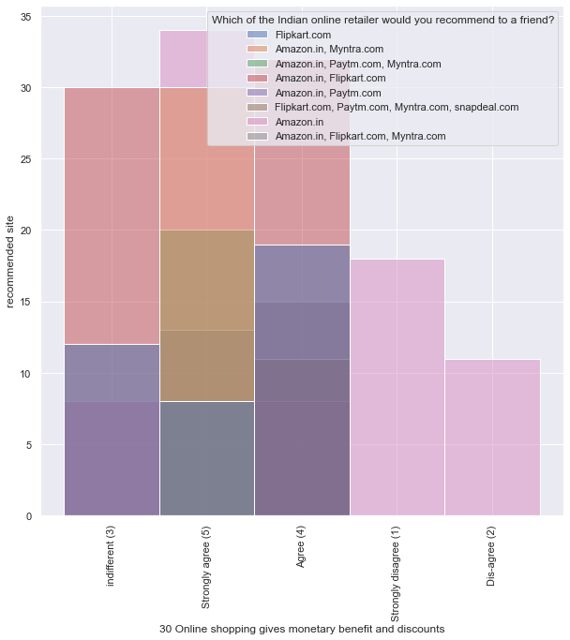
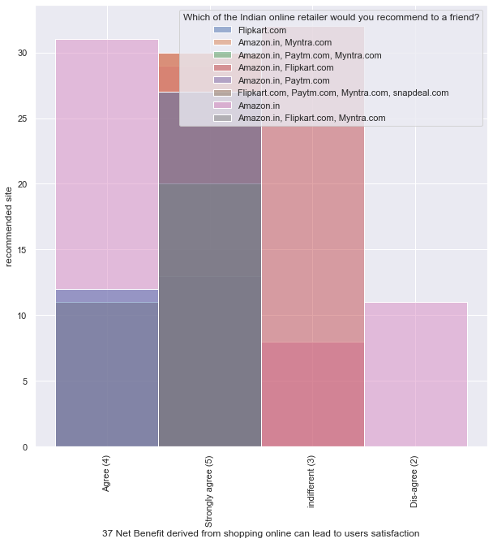
9) Monetary Benefits

Slide 44
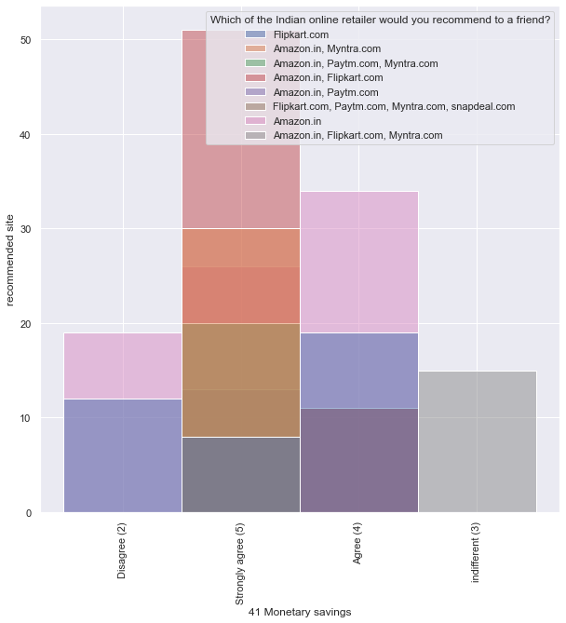
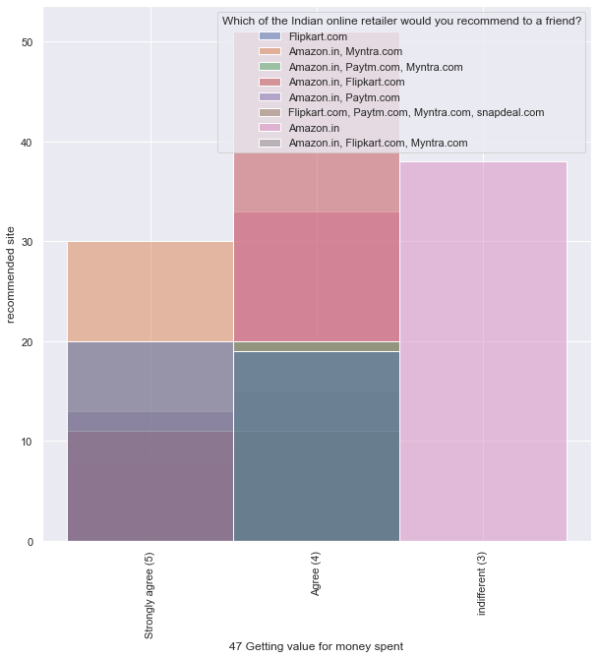

Slide 45
Observation: From the above graphs we can conclude that customers strongly agree and prefer those online shopping websites that provide discounts, monetary benefits and they feel that they are getting value for money.

Slide 46
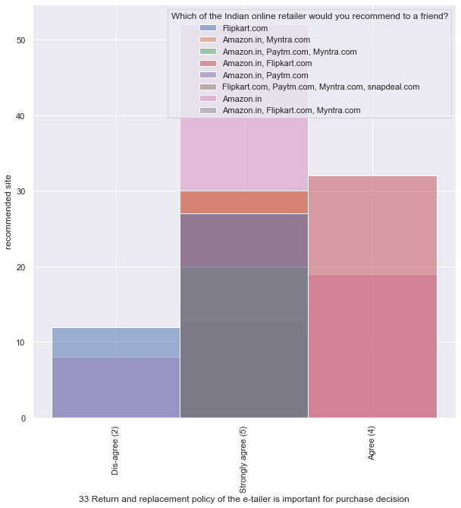
10) Return and Replacement
Observation: Return and replacement policy is very important factor for customers when doing online shopping.

Slide 47
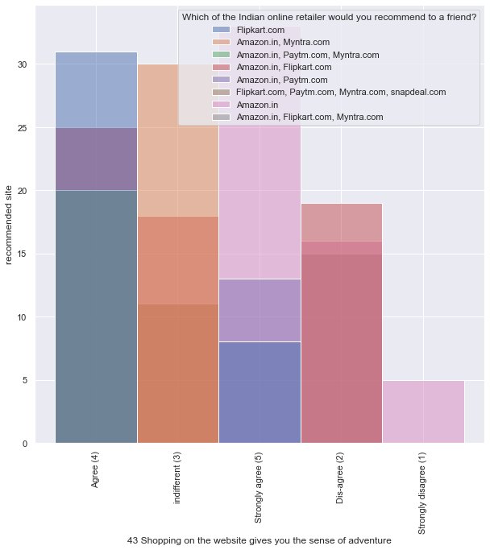
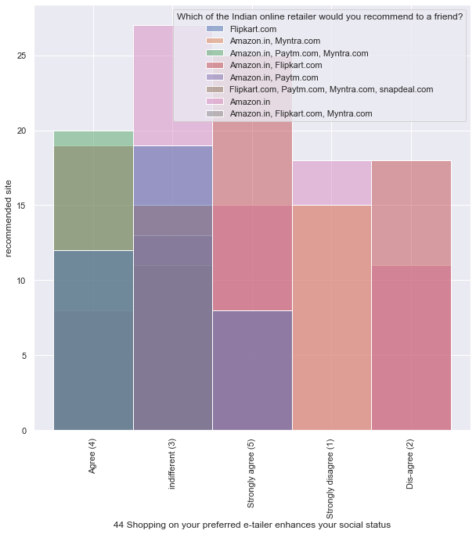
11) Social Status and Adventure

Slide 48
Observation: Customers strongly agree that doing online shopping give them a sense of adventure but is indifferent that it provides social status.

Slide 49
Conclusion

Slide 50
Following are the key factors that any online shopping organisation should consider to retain their customers: 1)User friendliness and easy to use website or application 2)Availability of almost all the payment options for all category of products mostly credit/debit card and cash on delivery. 3)Websites and applications should be created using such a technology so that the loading and processing speed is as fast as possible. 4)Customers query should be resolved as soon as possible and companies should show empathy towards them. 5)Online shopping companies should provide security and privacy to customers personal as well as financial data. 6)There should be frequent offers and discounts given by the site so that customers feel that every purchase is worth the cost. 7)There should be very flexible return and replacement policy. Keeping all these points we found that customers mostly recommended 2 online shopping websites: Amazon and Flipkart.

